Slide 1
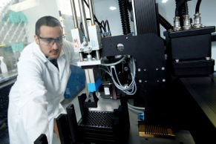
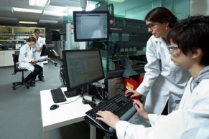
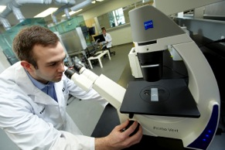
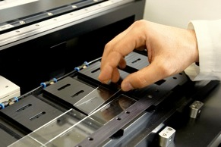
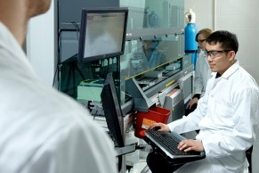
A New Vision for High Throughput Materials and Interfaces Research
Dr. John Brennan
April 2, 2013

Slide 2
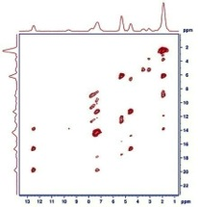
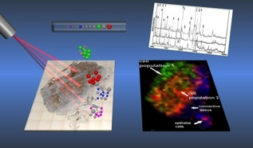
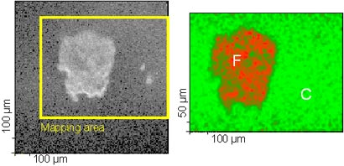
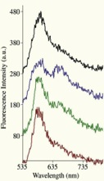
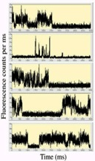
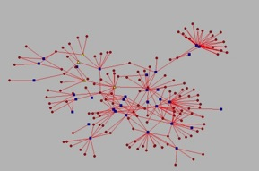
New Approaches to Materials Characterization
High Information Content Methods to Chart Biointerface Interactions
High end MS/MS for surface proteomics (stealth materials)
ssNMR – high field for extremely detailed interaction information
Imaging XPS for surface characterization
NSOM / TIRF gives single molecule level details of nature of environments
Database to bring together all data for modelling and new insights
2

Slide 3
Potential for Interfacial Materials
High-Throughput production of multiple surface chemistries
Rapidly produce materials with polymer or small molecule coatings
Rapidly print biological reagents onto substrates
High-Throughput characterization
Imaging XPS, MALDI, IR (quantity and distribution)
BIOACTIVITY SUITE (gels, immunoblots, protein binding)
Specifiv vs. non-specific binding
3

Slide 4
Thank You
Funding and Support
Fred Capretta
Cathy Bottos
Leanne Brown
Dawn White
Elna Luckham
Danielle Covelli
Dan Wallace
Brandon Aubie
Steve Kornic
biointerfaces.mcmaster.ca

